Slide 1
GAME310 Lesson 04
Artificial Intelligence
Friday, Sep 20th, 2019
Professor: Majid Moghadam

Slide 2
Objectives
Section 2: Moving
11. About Animation and Translation
12. An Introduction To Waypoints
Section 3: Cars
14. Unity’s Waypoint System

Slide 3
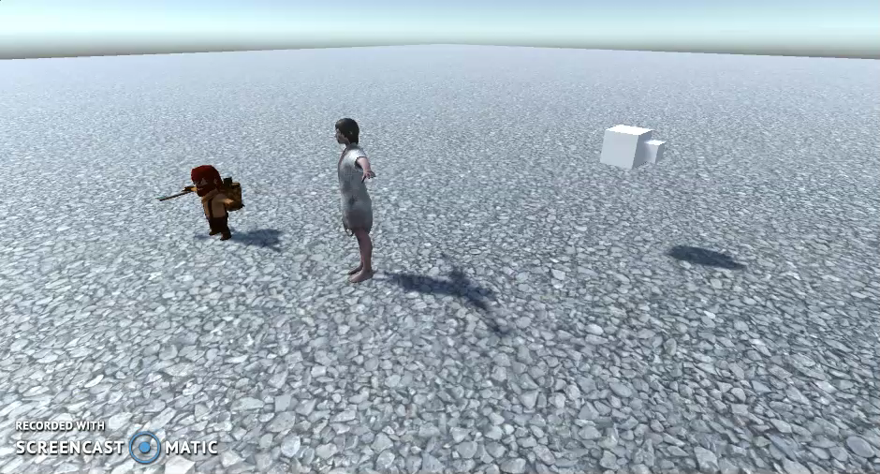
Section 2: Moving 11. About Animation And Translation
When using animated characters we need to be careful to match the characters own baked in animation (walking, running, etc..) and any physics we use to move the character forward.
If the timing is off, the character looks like it is sliding or skating along the floor
What’s happening is our forward propelling code is conflicting with the internal animation which is also trying to propel it forward
One can adjust this somewhat by adjusting speed parameters for our code or animation parameters of character

Slide 4
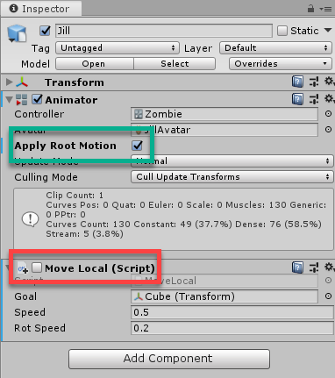

Section 2: Moving 11. About Animation And Translation (cont’d)
However if we use only the internal baked in animation we can use this to move the character forward.
Uncheck our own script attached to the zombie and check “apply root motion” on the Zombie animator
The character is now propelled forward its own animation, and things look a lot more natural….no slipping or sliding
However, we need to make it turn (Slerp!)

Slide 5
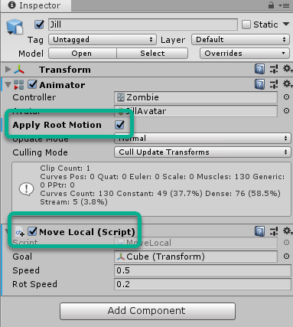
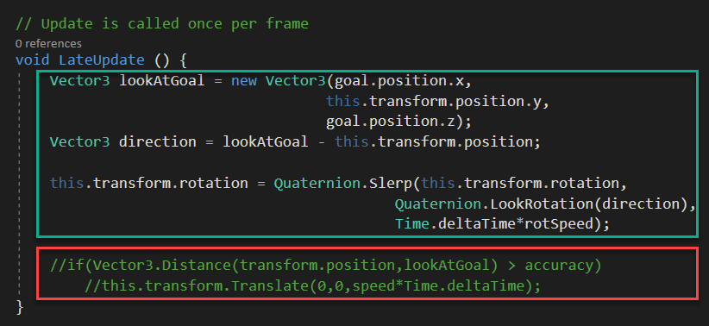
Section 2: Moving 11. About Animation And Translation (cont’d)
To get the Zombie to Slerp and use its own internal animation we turn back on the attached script BUT remove the code that pushes it forward
We keep the Slerp code, that makes it gradually rotate

Slide 6
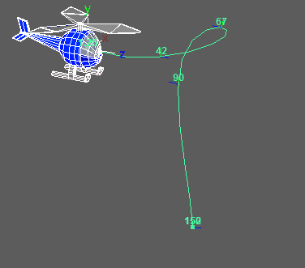
Section 2: Moving 12. An Introduction To Waypoints
Waypoints are simply positions on a map that, when navigated in sequence, produce a path.
It's the same system used in a car G.P.S. that gives you instructions on where to drive.
Waypoints are an easy system to implement in an NPC as it makes them look more intelligent than they are and by providing them with a safe set of locations on a map to move between, they can also avoid obstacles.
We've already created an NPC that can move and follow a goal location.
Updating this to a waypoint system is straightforward.

Slide 7
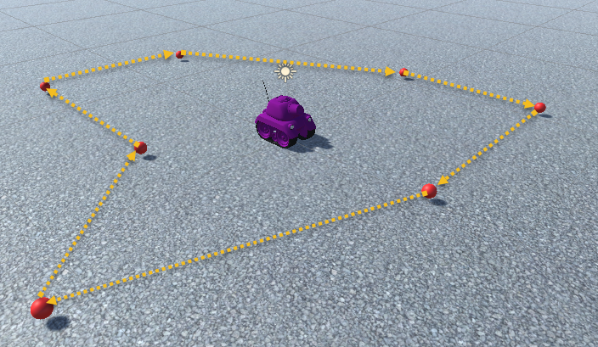
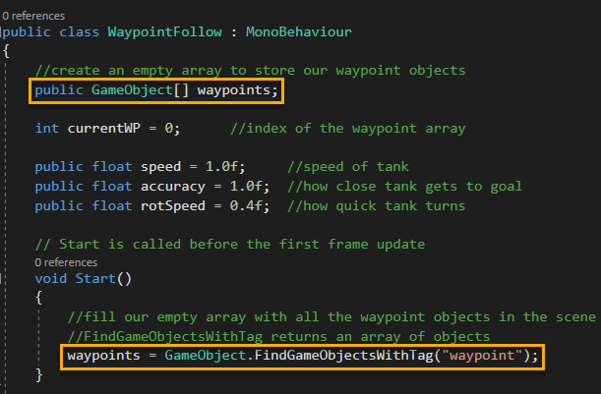
Section 2: Moving 12. An Introduction To Waypoints (cont’d)
Creating your own waypoint system
Add a bunch of red spheres in a particular path so you can see them
Label each of them as “waypoint”
Create a waypointFollow.cs script (see diagram)
In code store all waypoints in an array

Slide 8
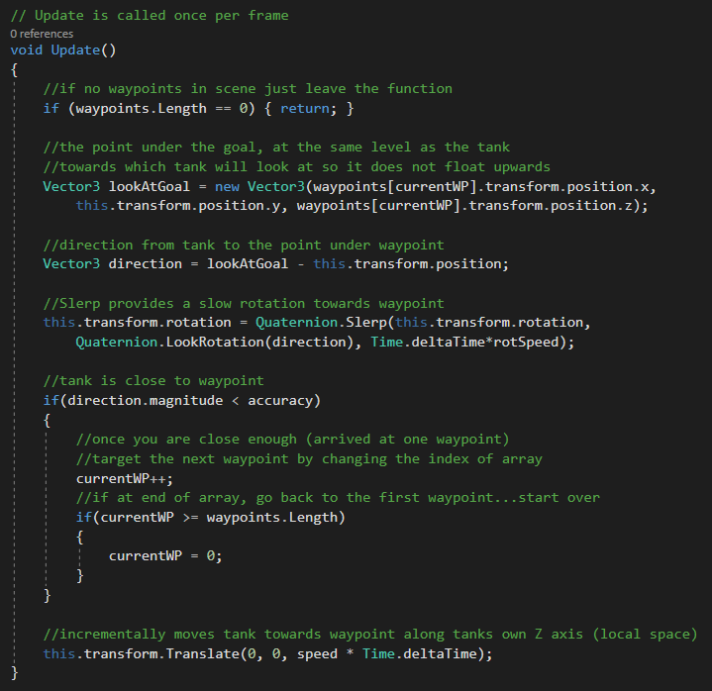
Section 2: Moving 12. An Introduction To Waypoints (cont’d)
Creating your own waypoint system (cont’d)
Script has the tank follow one waypoint at a time
Slowly rotate (slerp) towards waypoint and moves towards it
Once it reaches one waypoint it then targets the next
When tank completes the circuit it starts again
Direction of next waypoint
Turn to next waypoint
Reached waypoint?
Move to waypoint

Slide 9
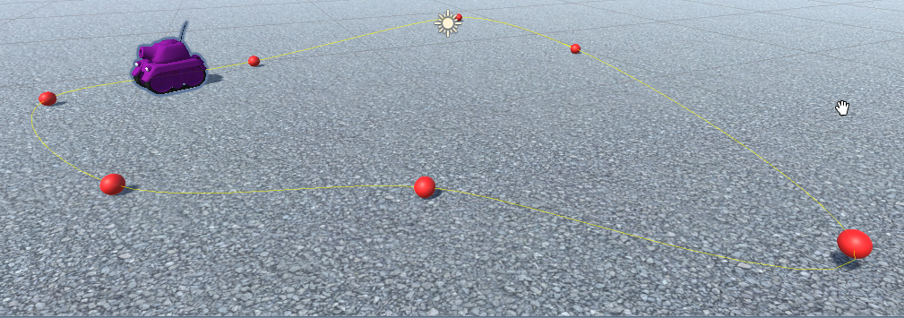
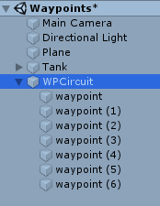
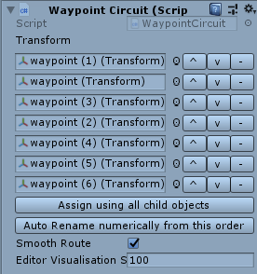
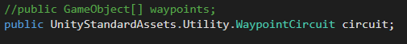
Section 3: Cars 14. Unity’s Waypoint System
Unity has its own built in waypoint system
It differs from the one we just built by using a waypoint circuit object
Waypoint circuit is an array of waypoints you create in the inspector
No need to find waypoints in code, already set in inspector
Yellow line shows you path of circuit
Can arrange waypoints in scene easily
Also, we use built in API’s in our code from UnityStandardAssets.Utility.WaypointCircuit

Slide 10
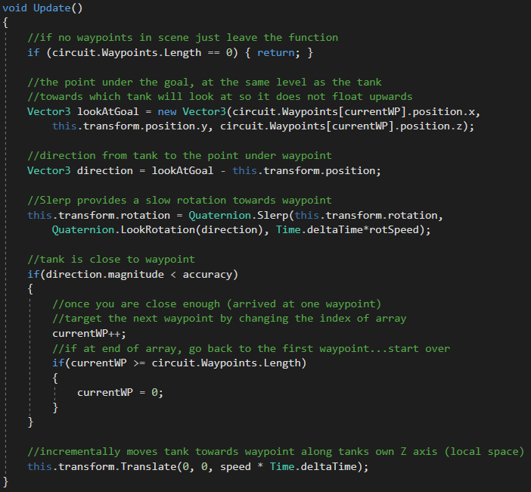
Section 3: Cars 14. Unity’s Waypoint System (cont’d)
Remainder of code removes the waypoint array and replaces it with the new circuit.Waypoint array

Slide 11
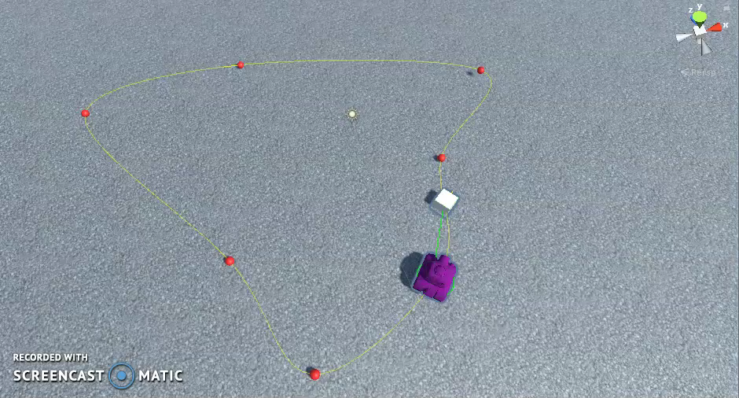
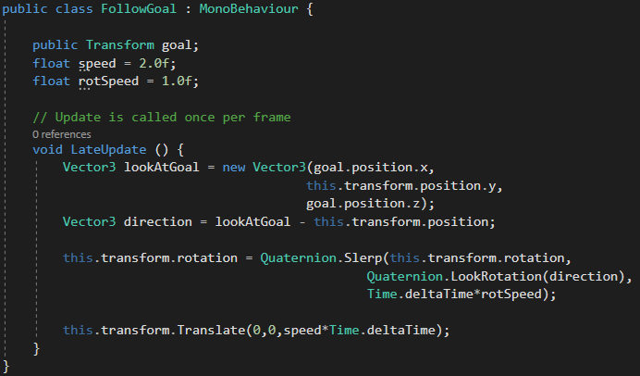
Section 3: Cars 14. Unity’s Waypoint System: ProgressTracker.cs Script
The ProgressTracker script is attached to the tank and helps guide its movement along the waypoint circuit
Must create an object for the tank to follow (cube). The cube will act as a goal.
The cube will stick to the circuit and be pushed forward by the ProgressTracker code and the tank will follow it.
In a real game the cube would not be visible but can be visible during development
Tank can cut corners, it has no knowledge and does not care about waypoints…only follows cube
Cube follows waypoints using Unity’s ProgressTracker.cs script.
Direction of goal
Turn to goal
Move to goal
No need for accuracy check, its chasing the same cube and will never get there (cube is a step ahead)

